Slide 1
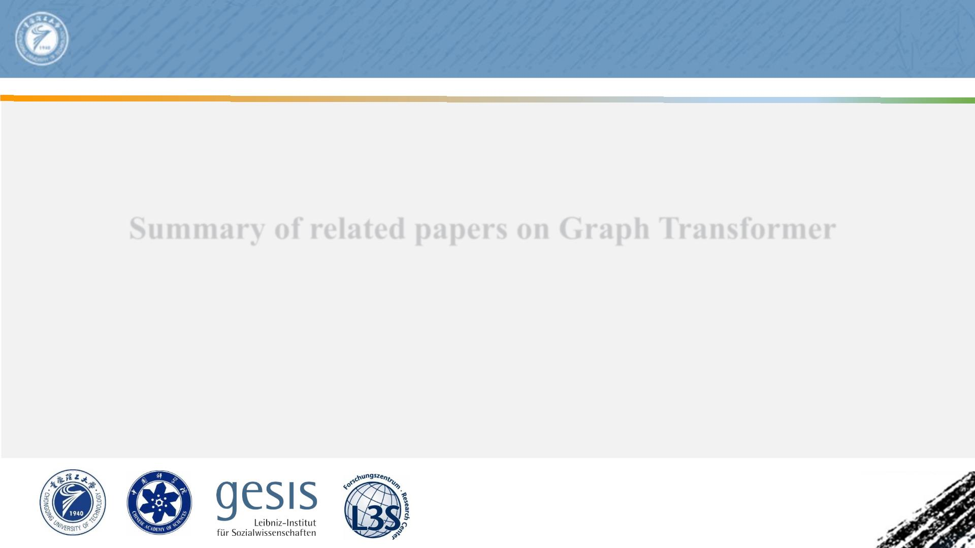
Chongqing University of
Technol ogy
ATA I
Advanced Technique of
Artificial Intel l i gence
Summary of related papers on Graph Transformer
Reported by Yidan Liu

Slide 2
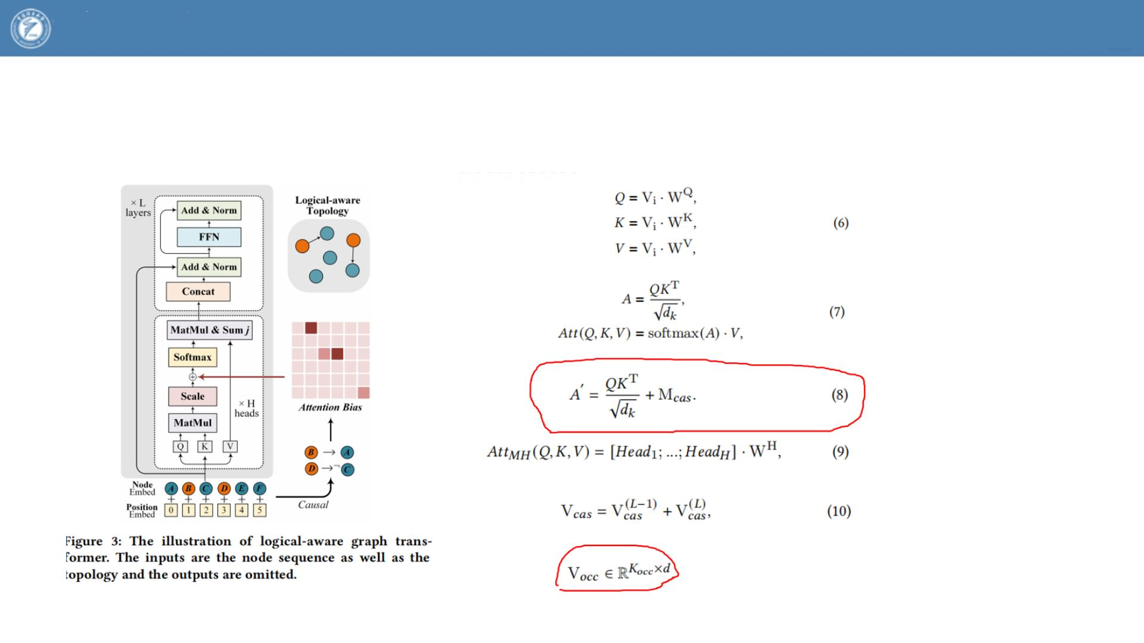
Chongqing University
of Technology
ATAI
Advanced Technique of
Artificial Intelligence
2022_SIGIR_LogiformerA Two-Branch Graph Transformer Network for Interpretable Logical Reasoning

Slide 3
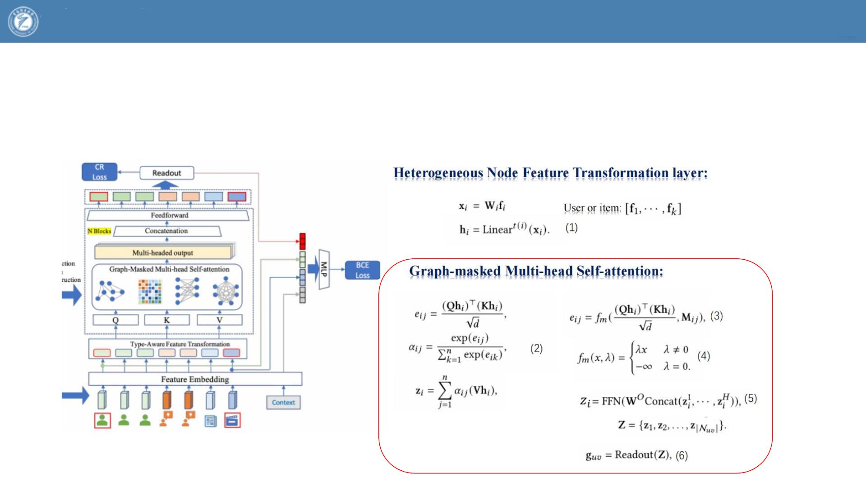
Chongqing University
of Technology
ATAI
Advanced Technique of
Artificial Intelligence
2022_SIGIR_Neighbour Interaction based Click-Through Rate Prediction via Graph-masked Transformer

